Slide 1
Unit 3
E-Government Infrastructure Development
1

Slide 2
E-Readiness
Degree of preparedness of a country for implementing e-governance
Defined in terms of availability of ICT infrastructure, the accessibility of ICT to the general citizen and business organization population, and the effect of the legal and regulatory framework on ICT use in, for example, an e-government strategy
E-Readiness is the ability to use information and communication technologies (ICT) to develop one's economy and to foster one's welfare.
Is the ability to pursue value creation opportunities facilitated by the use of the Internet.
Is a measure of e-business environment, a collection of factors that indicate how amenable (willing) a market is to Internet-based opportunities.
is not simply a matter of the number of computer servers, websites and mobile phones in the country, but also things such as its citizen's ability to utilize technology skillfully, the transparency of its business and legal systems, and the extent to which governments encourage the use of digital technologies.
2

Slide 3
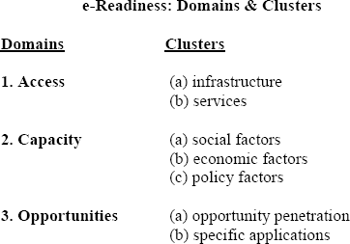
3

Slide 4
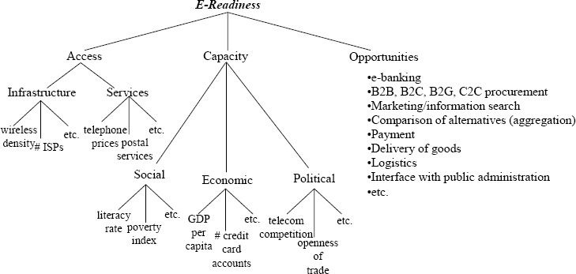
4

Slide 5
E-Readiness: Infrastructural Prerequisites
Data Systems Infrastructure
Legal Infrastructure
Human Infrastructure
Institutional Infrastructure
Technological Infrastructure
Leadership and Strategic Planning
5

Slide 6
E-Readiness: Data Systems Infrastructure
The core of e-governance is e-MIS and holds the entire database of any organization .
The data that were managed manually need to be computerized or brought into electronic form which means that the preparedness of computerized database or data warehouse is required.
Data quality and data security are of prime concern here as most of the government infrastructures are not up to the mark in developing countries.
The major question that arises here is “ Are all the requisite management information systems, records, databases and work processes in proper place so as to provide the quantity and quality of data to support the move to e-governance?”
This is the core computerization activity of any government process which may take several years to reach this stage.
6

Slide 7
E-Readiness: Legal Infrastructure
The manual processes in government are usually obsolete, inefficient and bureaucratic.
Though they have transformed to computerization practices, they continue to have poor and inefficient performance and this is due to lack of administrative reforms and lack of business process reengineering.
They lack requisite legislation and legal infrastructure to enable such reforms or reengineering of the existing business practices, rules and regulations within the government at various levels.
This seems to be accentuated in developing countries while developed countries have been significantly successful in administrative reforms and business reengineering.
The fundamental question that arises here is “ Are the laws and regulations required to permit and support the move towards e- governance initiatives in place?
E.g Digital Signature Act , legal acceptance of computer printed docs
7

Slide 8
E-Readiness: Institutional Infrastructure
For any government to implement a successful e-governance project, the required institutional infrastructure must be in place which most of the government lack.
The government body has to establish a separate IT department which basically coordinates with facilitators for e-government projects within the nation.
The IT department works out for the hardware selection and procurement, network or software development and implementation and also the training of staff at various levels of the government.
Many countries still lack the institutional infrastructure.
For example Natioanal Information technology center
https://nitc.gov.np/
8

Slide 9
E-Readiness: Human Infrastructure
Human resource development by training is an essential requirement which comes from well trained manpower both technical and non-technical.
The technical manpower resources are essential for all the phases of e- governance and related information system life cycle comprising systems
▪
analysis, design, programming, implementation, operation and documentation.
Both private and government institutions should play a major role in this regard.
Apart from technical human infrastructure, there is a need for the crucial training and orientation of user personnel i.e. government staff in e- governance project.
▪
The government employees and staff who are the stake-holders in all e- government projects as the end users are to be appropriately trained and oriented for change management from a manual government environment to e-governance environment.
Such training will make them competent and capable of handling e- governance projects at operational level
9

Slide 10
E-Readiness: Technological Infrastructure
Technology is fast changing in ICT domain and there is a rapid obsolescence of software as well as hardware which require great financial demands time to time.
Government organizations encounter this situation especially as their procedures to procure hardware or software are very inefficient and slow
The Latest technological infrastructure in developing countries including computing and telecommunication is absent. As a result software and hardware may not be compatible.
The major reasons are
cost of technology
Adaptability
Obsolescence
This is a serious limitation to e-governance implementation.
Innovtive solution for funding needed to be explored
10

Slide 11
E-Readiness: Leadership and Strategic Planning
Leadership
The ability to positively influence people and systems to have a meaningful impact and achieve results.
Strategic Planning
The process of envisioning an organization’s future and developing the necessary procedures and operations to achieve that future.
Strategic Planning
Leadership
Operations
Customer and Market Focus
11

Slide 12
Strategic Planning Process
Reason for existence
Future intent Attitudes and policies
Vision Guiding Principles
Mission
Environmental assessment
Capabilities and risks
Strategies
Broad statements of direction
Strategic Objectives
Things to change or improve
Implementation
12
Action Plans

Slide 13
Leading Practices - Strategic Planning
Active participation of top management, employees, customers, suppliers
Systematic planning systems for strategy development and deployment, including measurement, feedback, and review
Use of a variety of external and internal data
Align short-term action plans with long-term strategic objectives, communicate them, and track progress
13

Slide 14
Evolutionary Stages in E-Governance
E-governance evolves gradually from the simplest levels to advanced levels and the evolution may not be same in all cases.
Stage 1: Use of E-Mail and setting up of internal networking
Stage 2: Creation of Intranet infrastructure for access of internal activities
Stage 3: Allowing public access to information through Internet
Stage 4: Allowing 2-way interactive communication with stake holders to enable Internet enabled transactions (including financial transactions)
Stage 5: Allowing online transactions by the citizens
Stage 6: Enriching digital democracy
Stage 7: Electronically integrated or joined government with Legislature and Judiciary
14

Slide 15
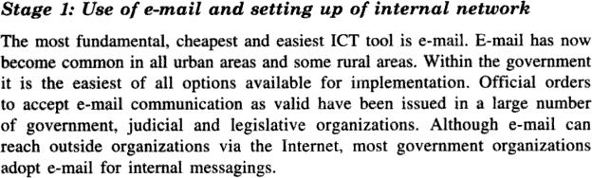
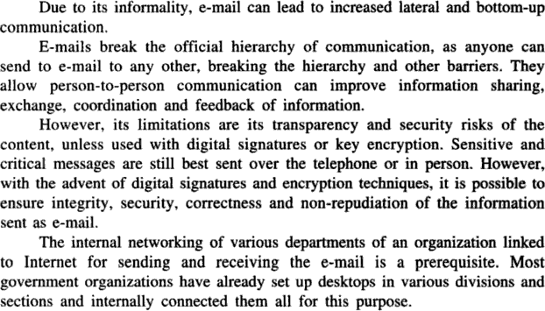
15

Slide 16
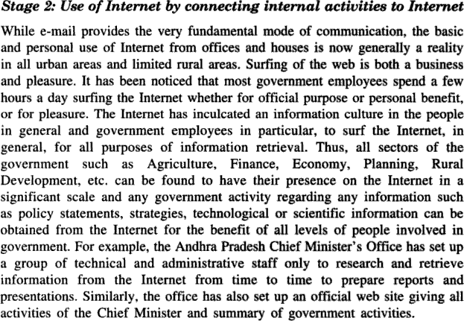
16

Slide 17
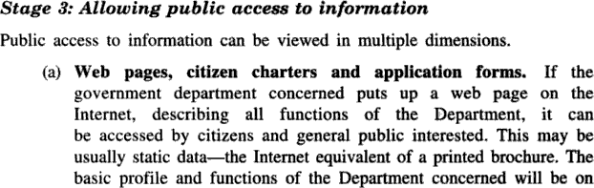
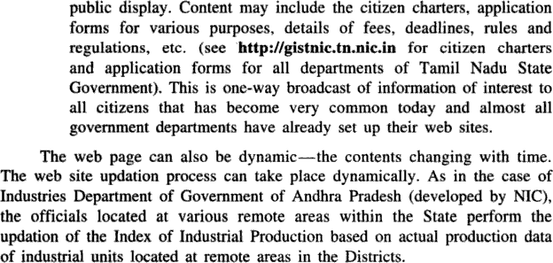
17

Slide 18
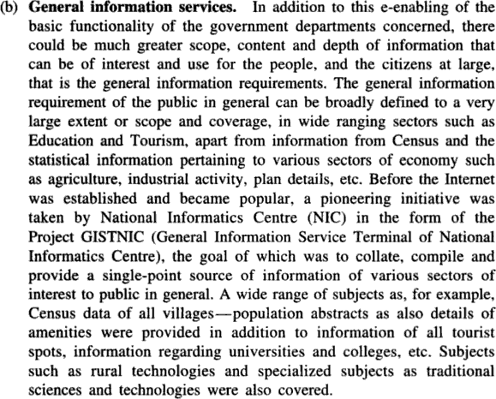
18

Slide 19
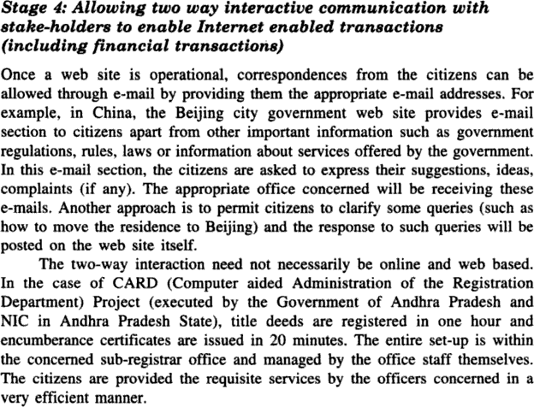
19

Slide 20
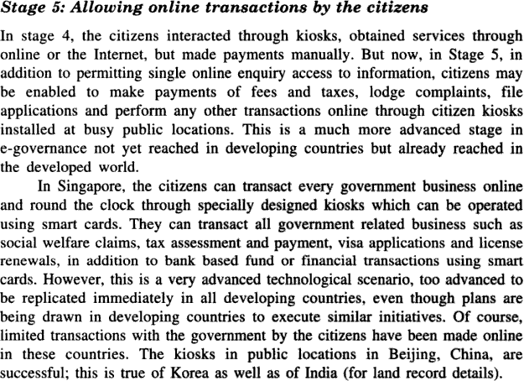
20

Slide 21
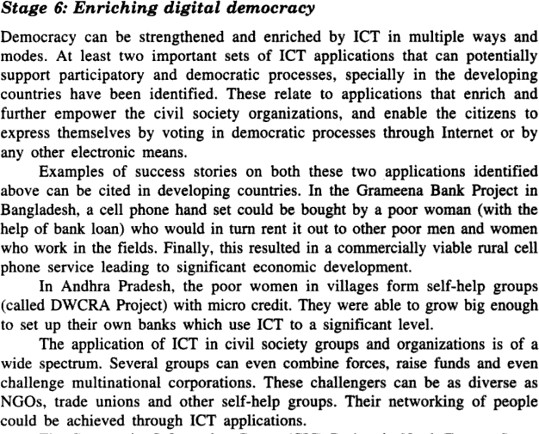
21

Slide 22
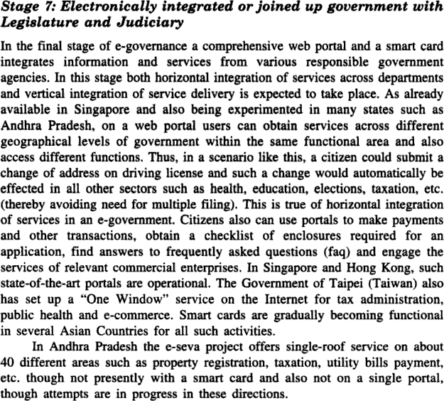
22

